Slide 1


Launching a Shopper Service in Limburg
IBM Capstone Project

Slide 2
The new normal creates new opportunities
The coronavirus pandemic has impacted the way people access and interact with retail and service businesses and administration tasks
Gig economy workers are also impacted due to restricted movement and business services allowed during restrictions
A personal assistant/shopper service catering to the needs of the highest risk citizens provide a unique business opportunity for independent contractors with high service delivery training and experience to be employed and launch a new business segment

Slide 3
Data acquisition and cleaning
Geographical data based on postal codes for the Limburg province in Belgium are sourced from http://www.geonames.org/
Age demographic data for Limburg province as at 1st January 2020 is sourced from https://statbel.fgov.be/en
Venue data based on the geographical dataset is sourced via API from www.foursquare.com using a free to use developer profile
Due to the limitation of the free profile, the dataset was further reduced based on potential successful conversion of at least 100 leads into paying customers.

Slide 4
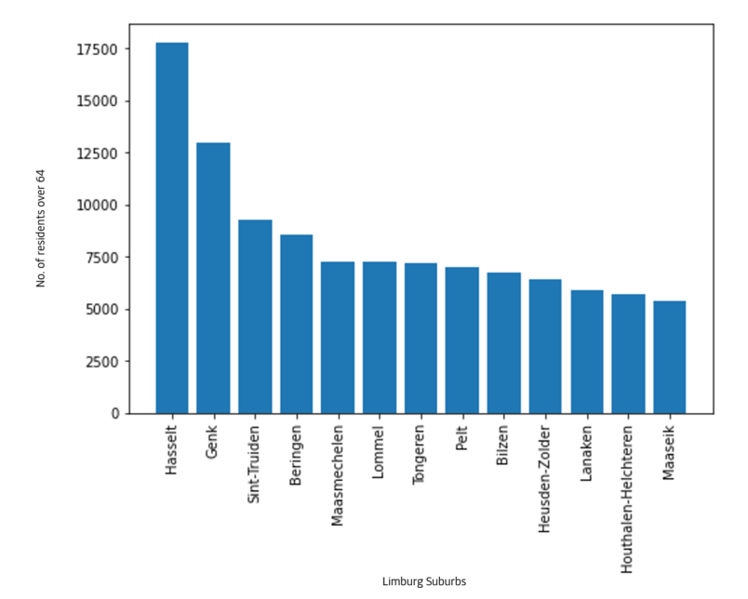
Final suburb list for selection

Slide 5
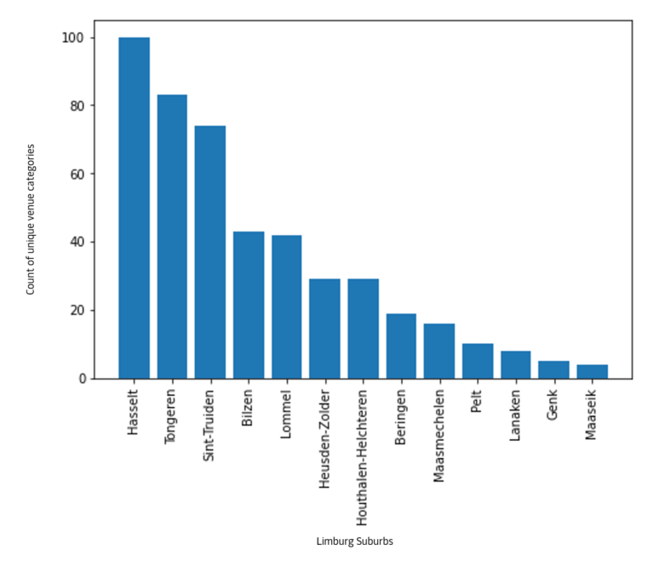
Venue categories per suburb

Slide 6
Evaluation and Conclusion
Based on the datasets, ranking was done for suburbs with the largest variety of venue and the suburbs with the largest target market
Individual rankings were weighted and produced a joint ranking based on the above criteria
Based on the final ranking the recommendation for the top 5 suburbs to potentially launch a shopper service in are :
Hasselt
Sint-Truiden
Tongeren
Lommel
Bilzen

